Slide 1




Slide 2

Syllabus
Memory Management Requirements, Relocation, Protection, Sharing, Logical Organization, Physical Organization.
Memory Partitioning: Fixed, Dynamic Partitioning, Relocation Fragmentation, Swapping.
Managing free Memory: Memory management with bitmap, linked list.
Paging: Basic Method, Structure of page Table.
Segmentation: Basic Method. Virtual Memory: Demand Paging,
Page replacement Algorithms- optimal, FIFO, LRU, Allocation of Frames, Thrashing.

Slide 3


Memory Management
Memory management is mainly concerned with the allocation of main memory to requesting process.
No process can ever run before a certain amount of memory is allocated to it.
The overall resource utilization and other performance criteria of a computer system are largely affected by the performance of the memory management module.

Slide 4

Memory Management Requirements

Slide 5

Memory Management Requirements
Relocation
Protection
Sharing
Logical Organization
Physical Organization

Slide 6
Memory Management Requirements
Relocation
programmer cannot know where the program will be placed in memory, when it is executed.
a process may be (often) relocated in main memory due to swapping.
swapping enables the OS to have a larger pool of ready-to-execute processes.
memory references in code (for both instructions and data) must be translated to actual physical memory address
6

Slide 7
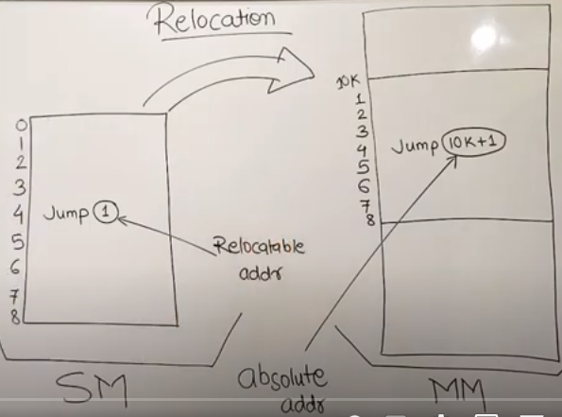

Slide 8
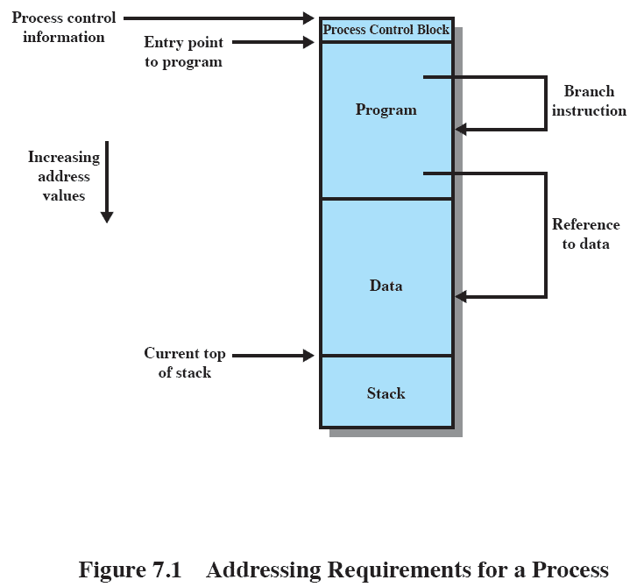
Memory Management Requirements

Slide 9
Memory Management Requirements
Process image occupies a contiguous region of main memory.
OS needs to know the location of process control information and of execution task, as well as the entry point to begin execution of program for this process.
Branch instructions contain an address to reference the instruction to be executed next.
Data reference instructions contain the address of the byte or word of data referenced.
Process hardware and OS software must be able to translate the memory references into actual physical memory addresses.

Slide 10
Memory Management Requirements
Protection
processes should not be able to reference memory locations in another process without permission.
impossible to check addresses at compile time in programs since the program could be relocated.
address references must be checked at run time by hardware.

Slide 11
Memory Management Requirements
Protection
Processes can refer only to the memory space allocated to those processes.
Program in one process cannot branch to an instruction in another process.
Program in one process cannot access data area of another process.
Memory protection requirement must be satisfied by processor hardware.

Slide 12
Memory Management Requirements
Sharing
must allow several processes to access a common portion of main memory without compromising protection.
cooperating processes may need to share access to the same data structure.
better to allow each process to access the same copy of the program rather than have their own separate copy.

Slide 13
Memory Management Requirements
Logical Organization
users write programs in modules with different characteristics :
🞄 instruction modules are execute-only
🞄 data modules are either read-only or read/write
🞄 some modules are private others are public
To effectively deal with user programs, the OS and hardware should support a basic form of module to provide the required protection and sharing.

Slide 14
Memory Management Requirements
Logical Organization
Advantages:
🞄 Modules can independently.
be written and compiled
🞄 Different degrees of protection(read only, execute only) can be given to different modules.
🞄 Possible to introduce mechanism by which modules can be shared among processes. User specifies sharing that is desired.

Slide 15
Memory Management Requirements
Physical Organization
secondary memory is the long term store for programs and data while main memory holds program and data currently in use.
moving information between these two levels of memory is a major concern of memory management (OS)
🞄 it is highly inefficient to leave this responsibility to the application programmer.

Slide 16
Memory Management Requirements
Physical Organization
Assigning responsibility to individual programmer is
impractical and undesirable for two reasons:
🞄 The main memory available for a program plus its data
may be insufficient.
Solution: Overlaying=> Program and data are organized in such a way that various modules can be assigned same region of the memory., with a main program responsible for switching modules in and out as needed. But overlay programming wastes programmer time.
🞄 In multiprogramming environment, the programmer does not know at the time of coding how much space
will be available or where that space will be.
15

Slide 17
Memory Partitioning

Slide 18

Introduction
The main memory operation in memory management is to swap processes in and out of the main memory for processor to execute.
In almost all of multiprog env. this involves the concept of virtual memory which is based on paging and segmentation.
But before going into that we need to understand some simpler techniques.

Slide 19
Introduction
But before going into that we need to understand some simpler techniques.
fixed partitioning
dynamic partitioning
paging
segmentation

Slide 20

Memory Partitioning Fixed Partitioning

Slide 21

Fixed Partitioning
In this one part of the main memory is dedicated to OS and other is available for remaining processes.
Main memory is divided into fixed size memory blocks say 8Mbytes.
So programs when loaded can be allocated to a particular block.
When all blocks are full, the OS can swap one process with other as per its placement techniques.
Examples of OS: An early IBM mainframe OS, OS/MFT

Slide 22

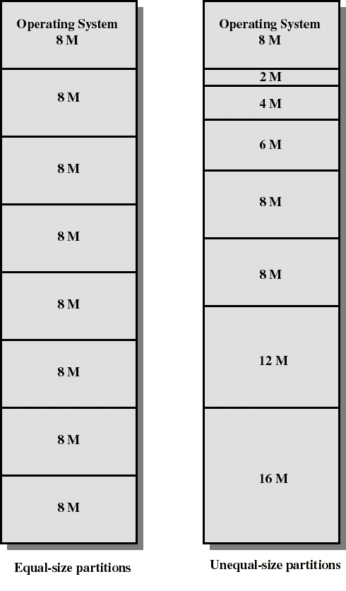

Fixed Partitioning
Partition
main
memory into a set of
non regions partitions.
overlapping
called
Partitions can be of equal or unequal sizes

Slide 23

Fixed Partitioning
any process whose size is less than or equal to a partition size can be loaded into the partition
if all partitions are occupied, the operating system can swap a process out of a partition

Slide 24

Fixed Partitioning
Two difficulties with the use of equal sized fixed partition :
a program may be too large to fit in a partition. The programmer must then design the program with overlays.
Overlaying: Keeping only some portion of the program in main memory and swapping as per requirement.
It creates internal fragmentation.

Slide 25

Fixed Partitioning
Internal Fragmentation
The situation when there is wasted space inside a partition when the amount of data allocated in that partition is smaller than the partition size
For e.g. The size of partition is 8Mbytes and the program is of size 2Mbytes but still it is given the whole 8Mbytes block in this technique.
Unequal-size partitions lessens these problems but they still remain…
24

Slide 26

Placement Algorithm with Partitions
Unequal-size partitions:
Two ways to assign processes to partitions.
🞄 Use of multiple queues
🞄 Use of single queue

Slide 27
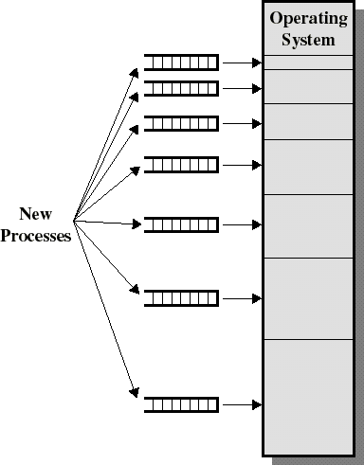
Placement Algorithm with Partitions
Unequal-size partitions:
use of multiple queues
assign each process to the smallest partition within which it will fit
A queue for each
partition size
tries to minimize internal fragmentation
Problem: some queues will be empty if no processes within a size range is present

Slide 28

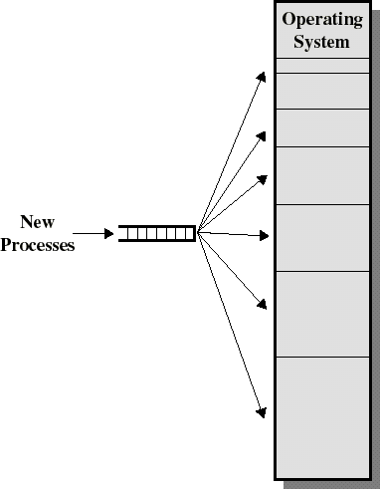
Placement Algorithm with Partitions
Unequal-size partitions:
use of a single queue
When its time to load a process into main memory the smallest available partition that will hold the process is selected.
increases the level of multiprogramming at the expense of internal fragmentation.
Swapping out of the
smallest partition.

Slide 29
Placement Algorithm with Partitions
Disadvantages of Unequal partition:
Number of partitions specified limits the number of processes
Partition sizes are preset at system generation time. So, small job will not utilize partition space efficiently.

Slide 30
Memory Partitioning Dynamic Partitioning

Slide 31

Dynamic Partitioning
Partitions are of variable length and number.
Each process is allocated exactly as much memory as it requires.
When a new process is there and memory available is not enough, swapping is done with another process.
Used in IBM’s OS/MVT (Multiprogramming
with a Variable number of Tasks)

Slide 32

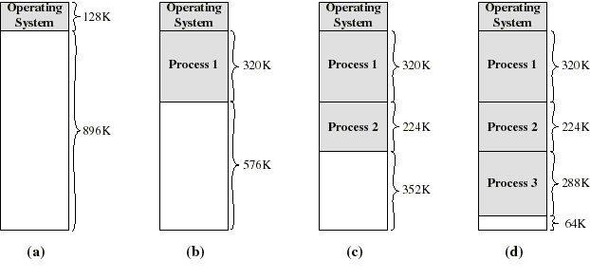
Dynamic Partitioning: an example
A hole of 64K is left after loading 3 processes: not enough
room for another process
Eventually each process is blocked.The OS swaps out
process 2 to bring in process 4

Slide 33
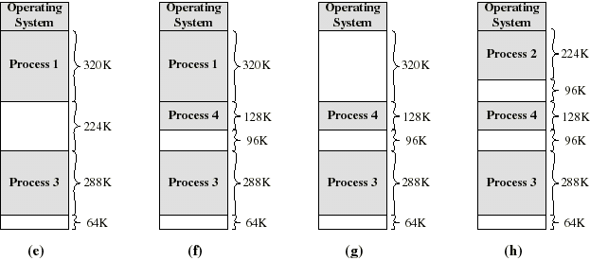
Dynamic Partitioning: an example
another hole of 96K is created
Eventually each process is blocked.The OS swaps out process 1 to bring in again process 2 and another hole of 96K is created...
Compaction would produce a single hole of 256K

Slide 34

Dynamic Partitioning
External Fragmentation:
The situation in which various
small sized
partitions are created is known as External Fragmentation.
External because the memory that is fragmented is not allocated to process, it is in
between the various process partitions opposite to that of
allocated internal
fragmentation.

Slide 35
Dynamic Partitioning
Compaction
Technique to resolve external fragmentation
OS shifts processes so they are contiguous and all free memory is in one block.
Problem is that compaction is time consuming and thus wastes processor’s time.

Slide 36

Placement Algorithm
Used to decide which free block to allocate to a process.
Goal: to reduce usage of compaction (time consuming)
Possible algorithms:
Best-fit: Allocate the smallest hole that is big enough. We must search the entire list, unless the list is ordered by size. This strategy produces the smallest leftover hole.

Slide 37
Placement Algorithm
First-fit: Allocate the first hole that is big enough. Searching can start either at the beginning of the set of holes or at the location where the previous first-fit search ended. We can stop searching as soon as we find a free hole that is large enough.
Worst-fit:
Allocate the largest hole. Again, we
must search the entire list, unless it is sorted by size. This strategy produces the largest leftover hole, which may be more useful than the smaller leftover hole from a best-fit approach.

Slide 38
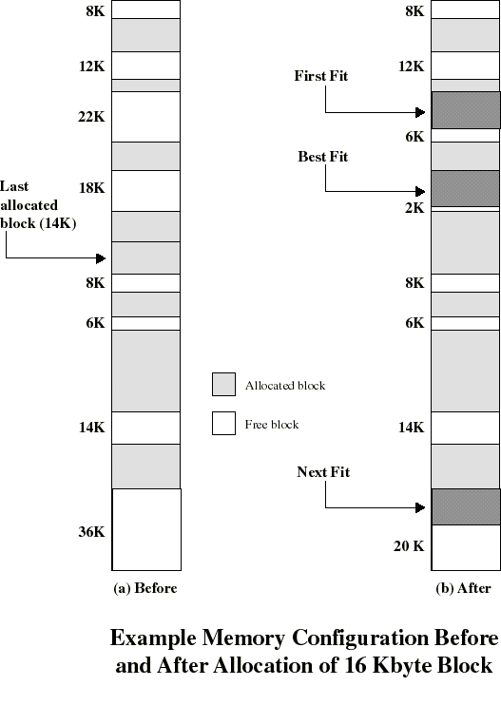

Placement Algorithm

Slide 39

Placement Algorithm: comments
Worst-fit often leads to allocation of the largest block at the end of memory
First-fit favors allocation near the beginning: tends to create less fragmentation than Next-fit
Best-fit searches for smallest block: the fragment left behind is small as possible
main memory quickly forms holes too small to hold any process: compaction generally needs to be done more often

Slide 40

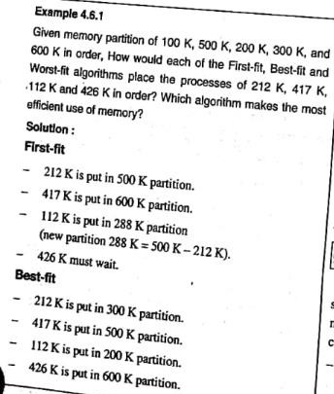
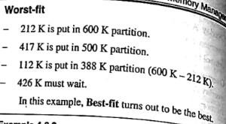
Example 1

Slide 41

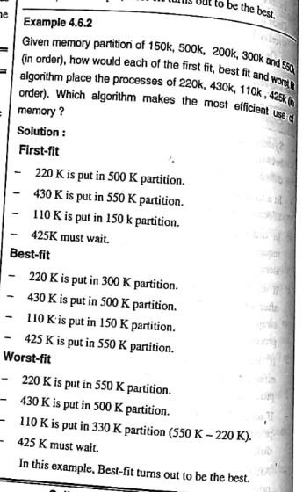
Example 2

Slide 42

Address Types
A physical address (absolute address) is a physical location in main memory. It is an address seen by Memory unit i.e. the one loaded into the memory address register.
A logical address: Is an address generated by CPU. It is a reference to a memory location independent of the physical structure/organization of memory.
Compilers produce code in which all memory references are logical addresses
43

Slide 43


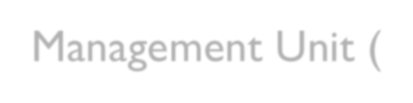


Memory-Management Unit (MMU)
Hardware device that maps virtual to physical address
In MMU scheme, the value in the relocation register is added to every address generated by a user process at the time it is sent to memory
The user program deals with logical addresses; it never sees the real physical addresses

Slide 44

Swapping
A process can be swapped temporarily out of memory to a backing store, and then brought back into memory for continued execution
Backing store – fast disk large enough to accommodate copies of all memory images for all users; must provide direct access to these memory images
Roll out, roll in – swapping variant used for priority-based scheduling algorithms; lower-priority process is swapped out so higher-priority process can be loaded and executed
Major part of swap time is transfer time; total transfer time is directly proportional to the amount of memory swapped
Modified versions of swapping are found on many systems
(i.e., UNIX, Linux, and Windows)
System maintains a ready queue of ready-to-run processes which have memory images on disk

Slide 45

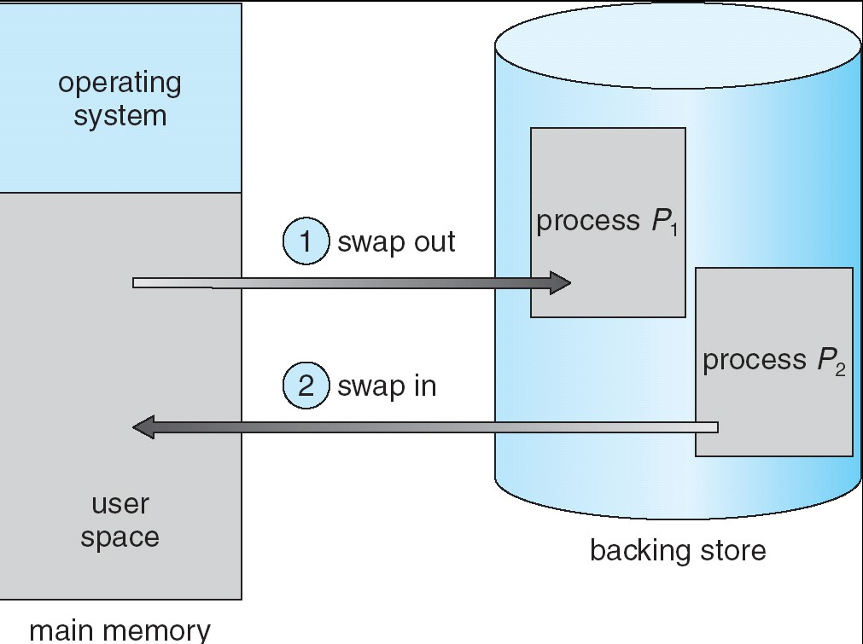
Schematic View of Swapping

Slide 46

Paging

Slide 47





Paging
Paging is a memory-management scheme that
permits the
physical address space a process to
be noncontiguous
.
Paging avoids external fragmentation and the need for compaction.
It also solves the considerable problem of fitting memory chunks of varying sizes onto the backing store.
Paging is implemented by closely integrating the hardware and operating system, especially on 64-bit microprocessors.

Slide 48

Paging
Divide physical memory into fixed-sized blocks called frames (size is power of 2, between 512 bytes and 8,192 bytes)
⚫
Divide logical memory into blocks of same size
called pages
.
When a process is to be executed, its pages are loaded into any available memory frames from their source (a file system or the backing store).
The backing store is divided into fixed-sized blocks that are of the same size as the memory frames.

Slide 49

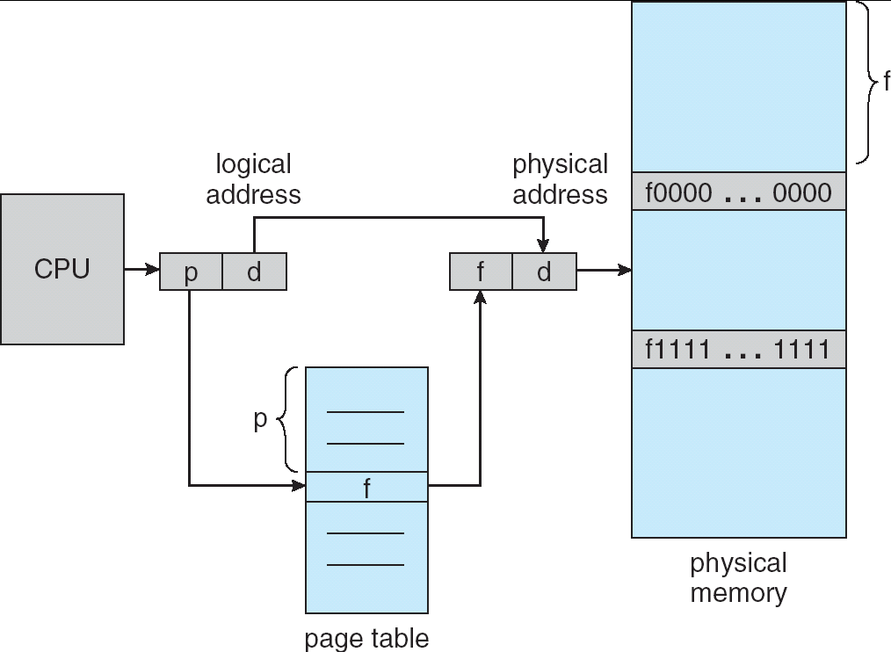
Paging Hardware

Slide 50
Paging
Every address generated by the CPU is divided into two parts: a Page Number (p) and a Page Offset.
The page number is used as an index into a page table.
The page table contains the base address of each page in physical memory.
This base address is combined with the page offset to define the physical memory address that is sent to the memory unit.

Slide 51

Address Translation Scheme
Address generated by CPU is divided into:
Page number (p) – used as an index into a page table which contains base address of each page in physical memory.
Page offset (d) – combined with base address to define the physical memory address that is sent to the memory unit.
The logical address is as follow. p is an index into the page
table and d is the displacement within the page.
page number page offset
p d
m - n n
For given logical address space 2^{m} and page size 2^{n.}

Slide 52

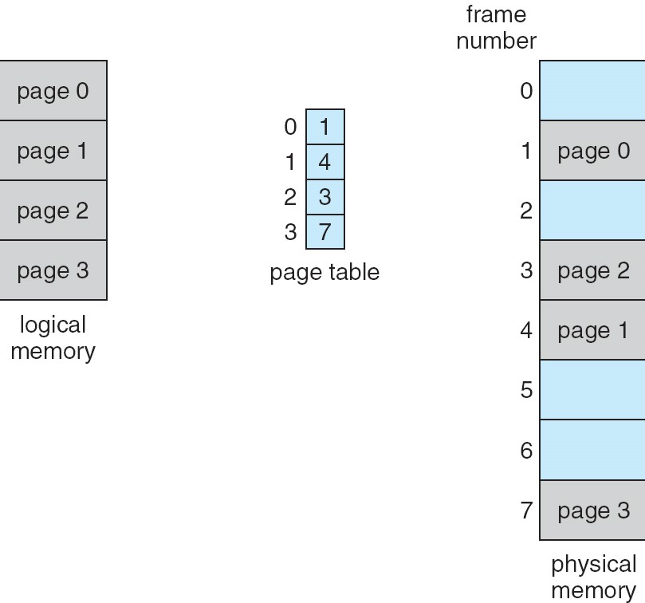
Paging Model of Logical and Physical Memory

Slide 53
Paging
The page size (like the frame size) is defined by the hardware.
The size of a page is typically a power of 2, varying between 512 bytes and 16 MB per page.
The selection of a power of 2 as a page size makes
the translation of a logical address into a page number and page offset particularly easy.
If the size of the logical address space is 2^{m}, and a page size is 2^{n} addressing units (bytes or words) then the high-order m- n bits of a logical address designate
the page number, and the n low-order bits designate the page offset.

Slide 54

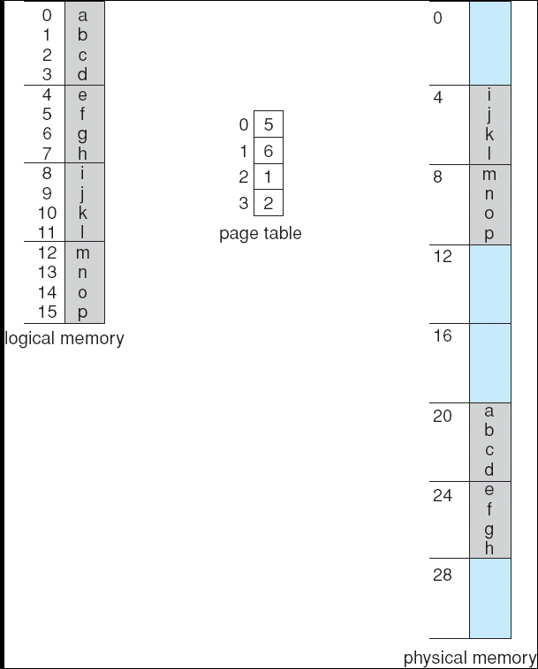

Paging Example
32-byte memory and 4-byte pages

Slide 55

Paging Example
Using a page size of 4 bytes and a physical memory of 32 bytes (8 pages).
Logical address 0 is page 0, offset 0.
Indexing into the page table, we find that page 0 is in frame 5.
Thus, logical address 0 maps to physical address 20 [= (5 x 4) + 0].
Formula=>
Physical address=(Frame No*Page size)+Offset

Slide 56
Paging Example
Logical address 3 (page 0, offset 3) maps to physical address 23 [ = (5 x 4) + 3].
Logical address 4 is page 1, offset 0; according to the page table, page 1 is mapped to frame 6.
Thus, logical address 4 maps to physical addres 24 [ = ( 6 x 4) + 0].
Logical address 13 maps to physical address 9.

Slide 57

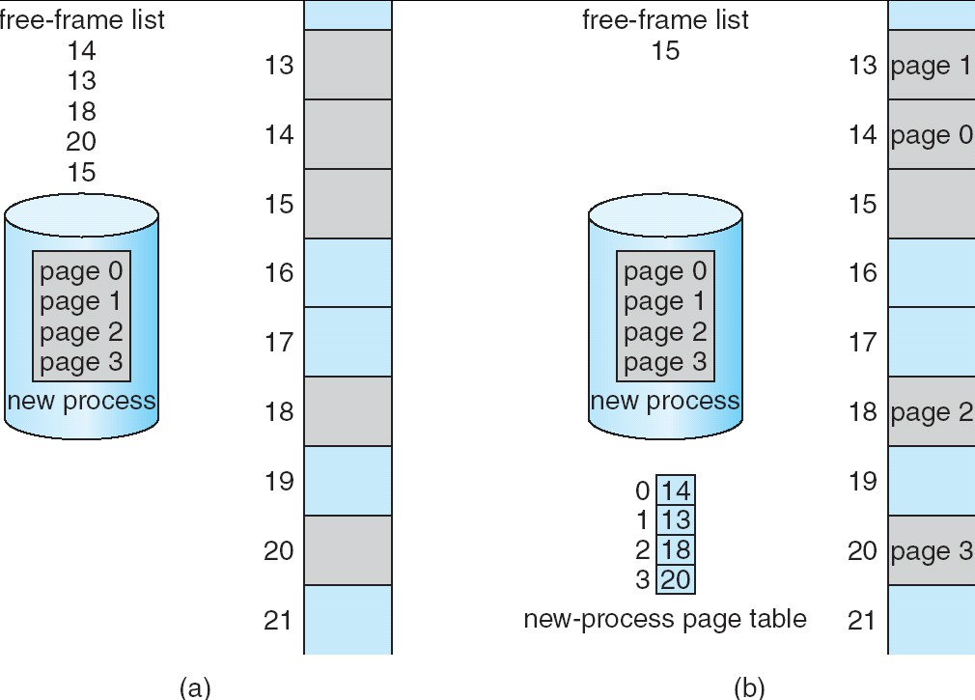
Free Frames
Before allocation
After allocation

Slide 58
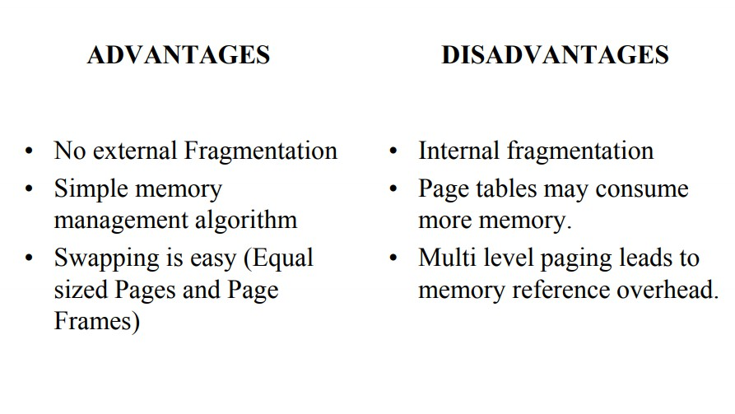

Slide 59
Segmentation

Slide 60

Segmentation
Memory-management scheme that supports user view of memory
A program is a collection of segments. A segment is a logical unit such as:
main program, procedure, function, method, object,
local variables, global variables, common block,
stack,
symbol table, arrays

Slide 61

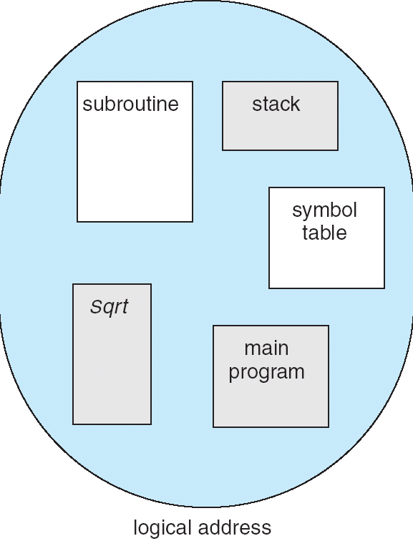
User’s View of a Program

Slide 62
Segmentation
A logical address space is a collection of segments.
Each segment has a name and a length. The addresses specify both the segment name and the offset within the segment.
segments are numbered and are referred to by a segment number, rather than by a segment name.
Thus, a logical address consists of a two tuple:
<segment-number, offset>.
the user program is compiled, and the compiler automatically constructs segments reflecting the input program.

Slide 63

Segmentation Hardware
map two dimensional user-defined addresses into one-dimensional physical addresses.
This mapping is effected by a Segment table.
Each entry in the segment table has a segment base and a segment limit.
The segment base contains the starting physical address where the segment resides in memory, and the segment limit specifies the length of the segment.

Slide 64

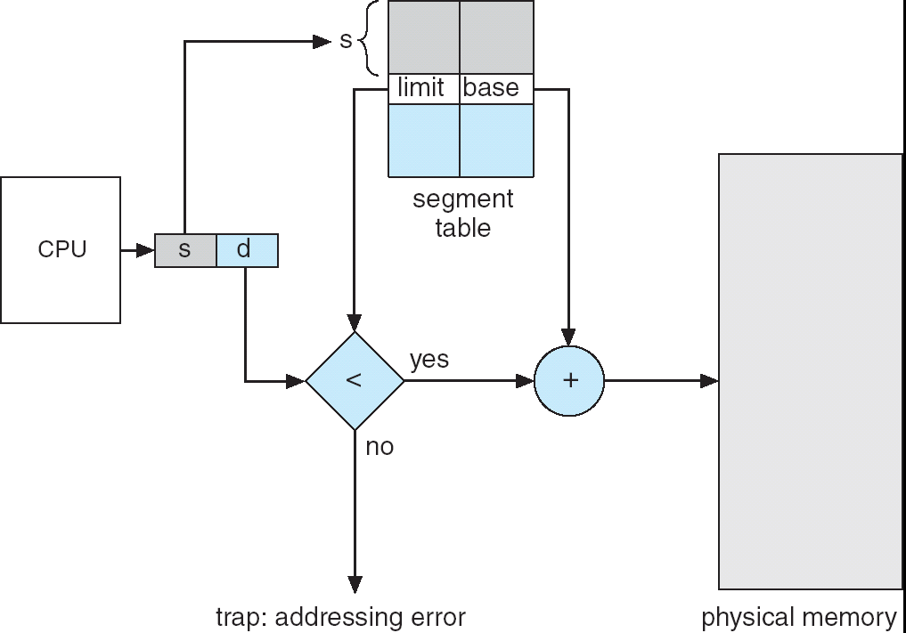
Segmentation Hardware

Slide 65
Segmentation Hardware
logical address consists of two parts: a segment number, s, and an offset into that segment, d.
The segment number is used as an index to the segment table.
The offset d of the logical address must be between 0 and the segment limit. If it is not, we trap to the operating system

Slide 66

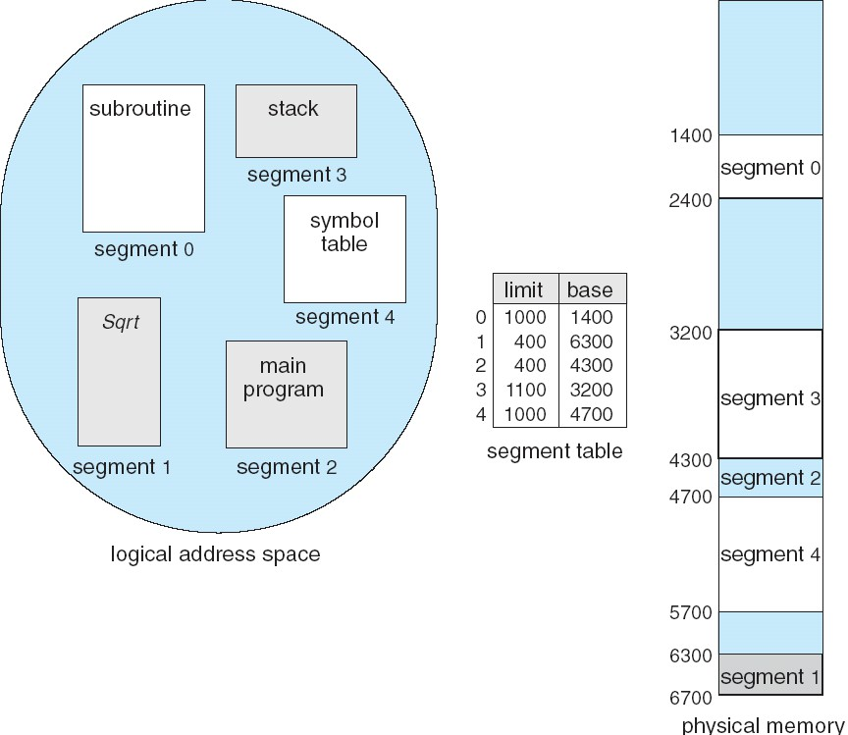
Example of Segmentation

Slide 67

Example
Example:
segment 2=> 400 bytes long and begins at location 4300.
Offset = 53 =>mapped to =>4300+53=4353bytes
Example:
segment 0=> 1000 bytes long and begins at location 1400.
Offset = 1222 => results in trap as this segment is 1000bytes long only.

Slide 68
Segmented Paging

Slide 69

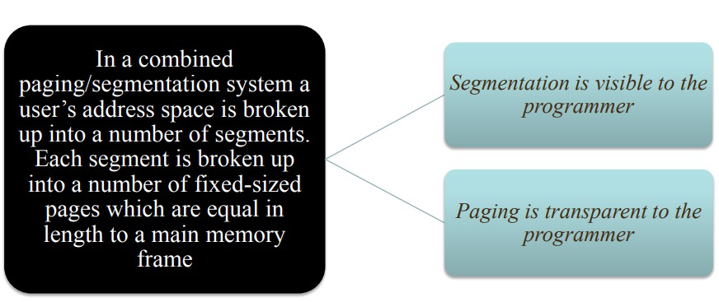
Segmented Paging

Slide 70
Segmented Paging
Pure segmentation is not very popular and not being used in many of the operating systems.
However, Segmentation can be combined with Paging to get the best features out of both the techniques.

Slide 71
Segmented Paging
In Segmented Paging, the main memory is divided into variable size segments which are further divided into fixed size pages.
Pages are smaller than segments.
Each Segment has a page table which means every program has multiple page tables.
The logical address is represented as Segment Number (base address), Page number and page offset.

Slide 72
Virtual Memory Management

Slide 73

Virtual memory
Virtual memory allows the execution of processes that are not completely in memory.
Only part of the program needs to be in memory for execution.
Advantage: programs can be larger than physical memory.
Virtual memory allows processes to share files easily and to implement shared memory.
Provides an efficient mechanism for process creation.

Slide 74

Virtual memory
In many cases, the entire program is not needed. For instance, consider the following:
Programs often have code to handle unusual error conditions. Since these errors seldom, if ever, occur in practice, this code is almost never executed.
Arrays, lists, and tables are often allocated more memory than they actually need. An array may be declared 100 by 100 elements, even though it is seldom larger than 10 by 10 elements.
Certain options and features of a program may be used rarely. For instance, the routines on U.S. government computers that balance the budget have not been used in many years.

Slide 75

Virtual memory
The ability to execute a program that is only partially in memory would confer many benefits:
Users would be able to write programs for an extremely large virtual address space.
Because each user program could take less physical memory, more programs could be run at the same time.
Less I/O would be needed to load or swap user programs into memory, so
each user program would run faster.

Slide 76
Virtual memory
Virtual memory involves the separation of logical memory as perceived by users from physical memory.
This separation allows an extremely large virtual memory to be provided for programmers when only a smaller physical memory is available.

Slide 77

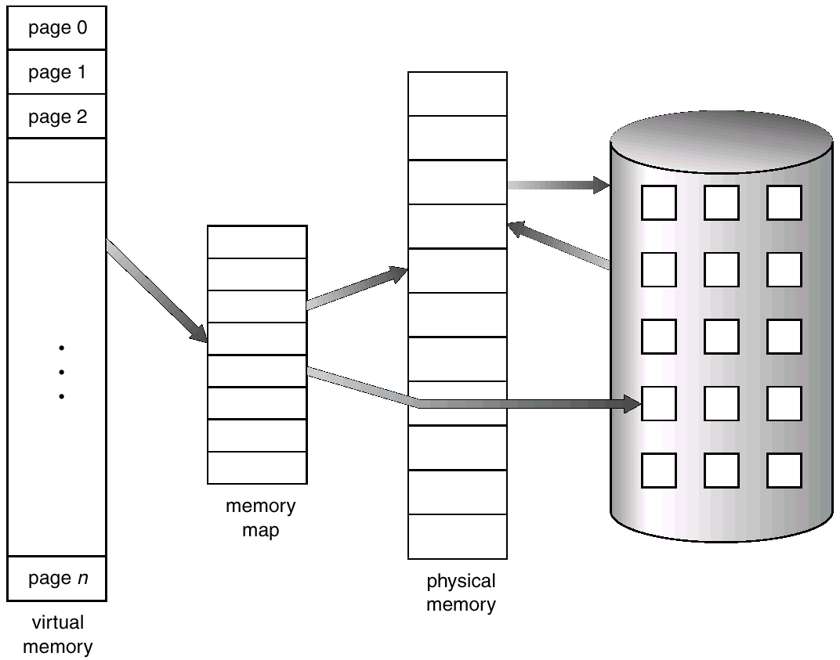
Virtual Memory That is Larger Than Physical Memory
Operating System Concepts

Slide 78
Implementation of virtual memory using Demand Paging

Slide 79

Demand Paging
Bring a page into memory only when it is needed.
Less I/O needed
Less memory needed
Faster response
More users
Lazy swapper – never swaps a page into memory unless
page will be needed.
Swapper that deals with pages is a pager.
Page is needed ⇒ reference to it
invalid reference ⇒ abort
not-in-memory ⇒ bring to memory

Slide 80

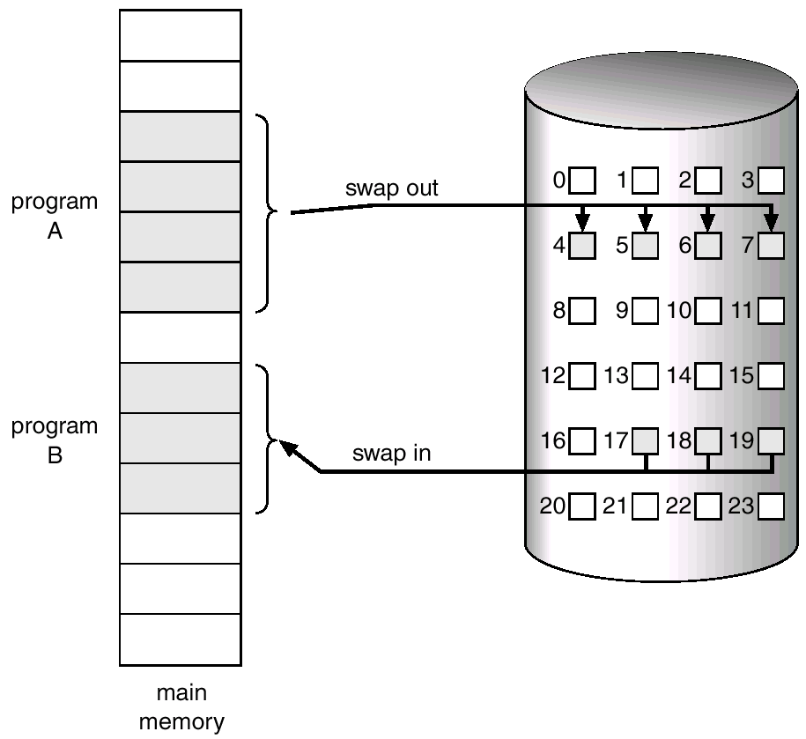
Transfer of a Paged Memory to Contiguous Disk Space
Roll-out
Roll-in

Slide 81



Valid-Invalid Bit
With each page table entry a valid–invalid bit is associated (1 / v⇒ in-memory, 0/i ⇒ not-in-memory)
Initially valid–invalid but is set to 0 on all entries.
Example of a page table snapshot.
Frame # | valid-invalid bit 1
 | 1
 | 1
 | 1
 | 0
⁝
 | 0
 | 0
page table
During address translation, if valid–invalid bit in page table entry is 0 ⇒ page fault.

Slide 82
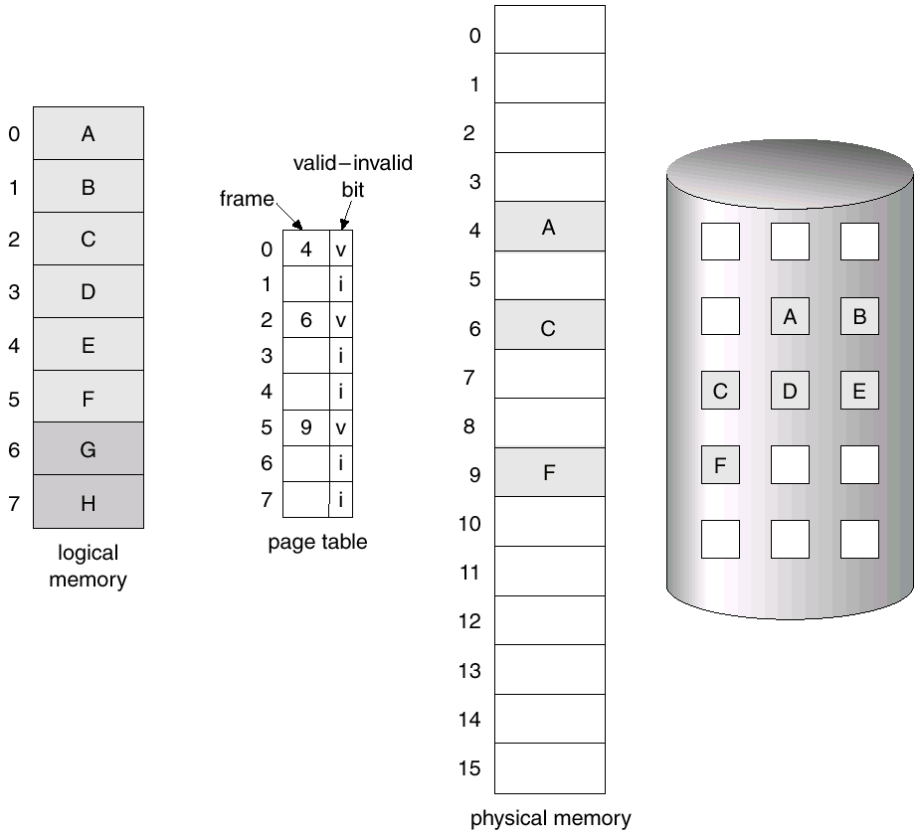
Page Table When Some Pages Are Not in Main Memory
Disk

Slide 83

Page Fault
What if the process refers to (i.e., tries to access) a page not in-memory ?
The first reference (i.e., address) to that invalid page will trap to operating system and causes a page fault

Slide 84
Page Fault
Procedure for handling a page fault :
OS checks an internal table to see if reference is valid or invalid memory access.
If Invalid reference : abort the process.
⇒address is not in logical address space of process.
Just not in memory : page in the referred page from the disk.
=>logical address is valid but page is simply not in Memory

Slide 85
Page Fault
Procedure for handling a page fault :
Cont….
Find a free frame.
Read the referred page into this allocated frame via scheduled disk operation.
Update both internal table and page-table by setting validation bit = v.
Restart the instruction that caused the page fault and resume process execution.

Slide 86

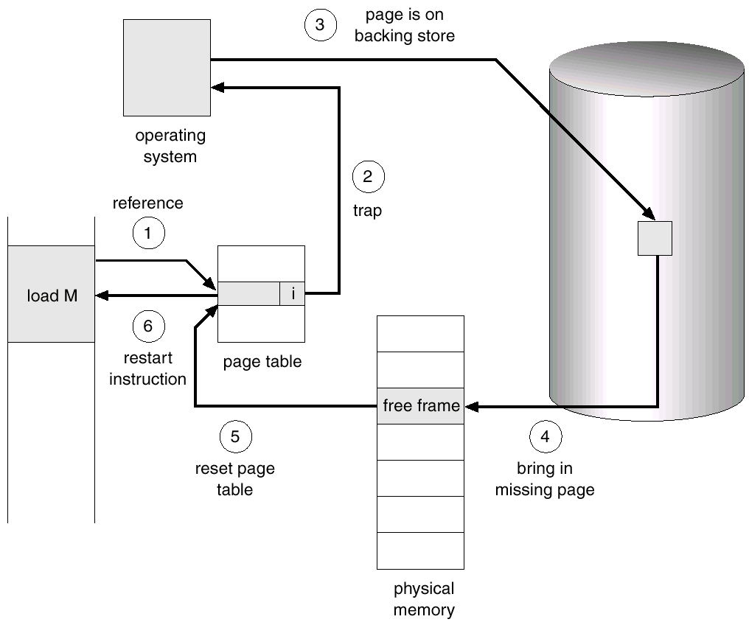
Steps in Handling a Page Fault
Operating System Concepts

Slide 87

What happens if there is no free frame?
Page replacement – find some page in memory, but not really in use, swap it out.
algorithm
performance – want an algorithm which will result in minimum number of page faults.
Same page may be brought into memory several times.
Operating System Concepts

Slide 88

Hardware Support
Hardware support needed for demand paging; same as hardware for paging and swapping
Page table: with valid / invalid bit, or special protection bits
Secondary memory: swap device with swap space; for not in-memory pages

Slide 89

Page Replacement Algorithms

Slide 90

Page Replacement
Prevent over-allocation of memory by modifying page-fault service routine to include page replacement.
Use modify (dirty) bit to reduce overhead of page transfers – only modified pages are written to disk.
Page replacement completes separation between logical memory and physical memory – large virtual memory can be provided on a smaller physical memory.

Slide 91

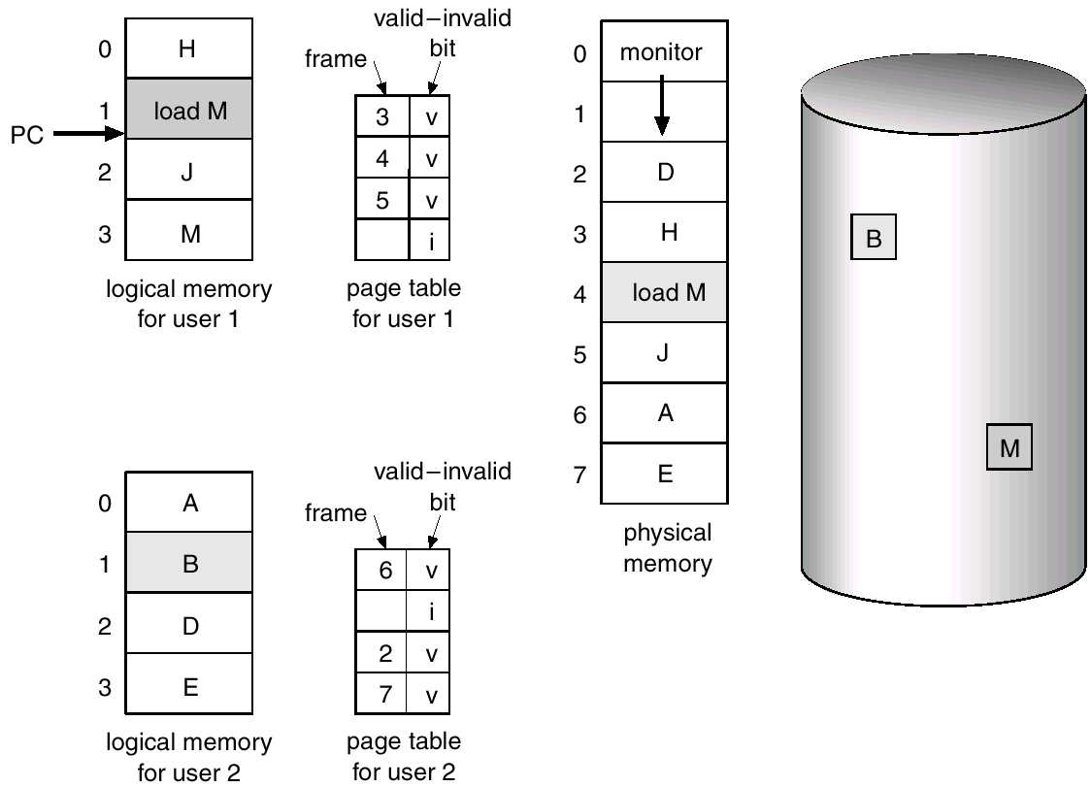
Need For Page Replacement

Slide 92

Basic Page Replacement
Find the location of the desired page on disk.
Find a free frame:
If there is a free frame, use it.
If there is no free frame, use a page replacement algorithm to select a victim frame.
Read the desired page into the (newly) free frame. Update the page and frame tables.
Restart the process.

Slide 93

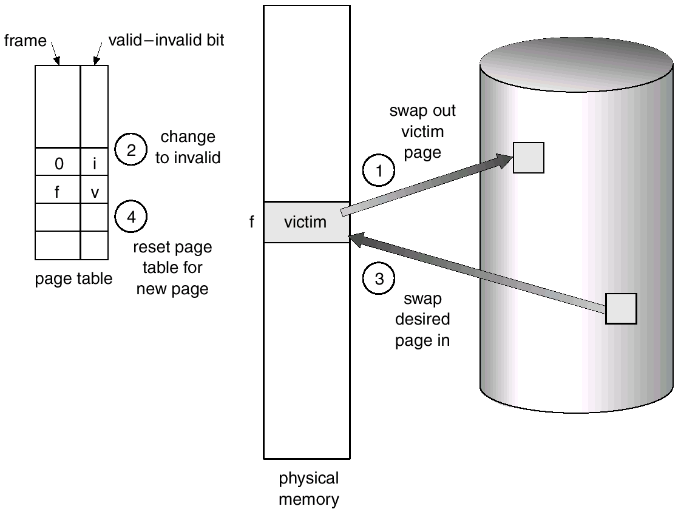
Page Replacement

Slide 94

Page Replacement Algorithms
Want lowest page-fault rate.
Evaluate algorithm by running it on a particular string of memory references (reference string) and computing the number of page faults on that string.
Operating System Concepts

Slide 95
First-In-First-Out

Slide 96







First-In-First-Out (FIFO) Algorithm
A FIFO replacement algorithm associates with each page the time when that page was brought into memory.
Each page brought into memory is inserted into a first-in first-out queue.
Page to be replaced is the oldest page; the one at the head of the queue.
When a page is brought into memory, we insert it at the tail of the queue.
Example:
Reference string: 7, 0, 1, 2, 0, 3, 0, 4, 2, 3, 0, 3, 2, 1, 2, 0, 1, 7, 0, 1
Frame size = 3

Slide 97
First-In-First-Out (FIFO) Algorithm
Reference string: Frame size = 3
7, 0, 1, 2, 0, 3, 0, 4, 2, 3, 0, 3, 2, 1, 2, 0, 1, 7, 0, 1

Slide 98
First-In-First-Out (FIFO) Algorithm
Reference string: Frame size = 3
7, 0, 1, 2, 0, 3, 0, 4, 2, 3, 0, 3, 2, 1, 2, 0, 1, 7, 0, 1
7

Slide 99
First-In-First-Out (FIFO) Algorithm
Reference string: Frame size = 3
7, 0, 1, 2, 0, 3, 0, 4, 2, 3, 0, 3, 2, 1, 2, 0, 1, 7, 0, 1
7
7
0

Slide 100
First-In-First-Out (FIFO) Algorithm
Reference string: Frame size = 3
7, 0, 1, 2, 0, 3, 0, 4, 2, 3, 0, 3, 2, 1, 2, 0, 1, 7, 0, 1
7
7
0
7
0
1

Slide 101
First-In-First-Out (FIFO) Algorithm
Reference string: Frame size = 3
7, 0, 1, 2, 0, 3, 0, 4, 2, 3, 0, 3, 2, 1, 2, 0, 1, 7, 0, 1
7
7
0
7
0
1
2
0
1

Slide 102
First-In-First-Out (FIFO) Algorithm
Reference string: Frame size = 3
7, 0, 1, 2, 0, 3, 0, 4, 2, 3, 0, 3, 2, 1, 2, 0, 1, 7, 0, 1
7
7
0
7
0
1
2
0
1
2
0
1

Slide 103
First-In-First-Out (FIFO) Algorithm
Reference string: Frame size = 3
7, 0, 1, 2, 0, 3, 0, 4, 2, 3, 0, 3, 2, 1, 2, 0, 1, 7, 0, 1
7
7
0
7
0
1
2
0
1
2
0
1
2
3
1

Slide 104
First-In-First-Out (FIFO) Algorithm
Reference string: Frame size = 3
7, 0, 1, 2, 0, 3, 0, 4, 2, 3, 0, 3, 2, 1, 2, 0, 1, 7, 0, 1
7
7
0
7
0
1
2
0
1
2
0
1
2
3
1
2
3
0

Slide 105
First-In-First-Out (FIFO) Algorithm
Reference string: Frame size = 3
7, 0, 1, 2, 0, 3, 0, 4, 2, 3, 0, 3, 2, 1, 2, 0, 1, 7, 0, 1
7
7
0
7
0
1
2
0
1
2
0
1
2
3
1
2
3
0
4
3
0

Slide 106
First-In-First-Out (FIFO) Algorithm
Reference string: Frame size = 3
7, 0, 1, 2, 0, 3, 0, 4, 2, 3, 0, 3, 2, 1, 2, 0, 1, 7, 0, 1
7
7
0
7
0
1
2
0
1
2
0
1
2
3
1
2
3
0
4
3
0
4
2
0

Slide 107
First-In-First-Out (FIFO) Algorithm
Reference string: Frame size = 3
7, 0, 1, 2, 0, 3, 0, 4, 2, 3, 0, 3, 2, 1, 2, 0, 1, 7, 0, 1
7
7
0
7
0
1
2
0
1
2
0
1
2
3
1
2
3
0
4
3
0
4
2
0
4
2
3

Slide 108
First-In-First-Out (FIFO) Algorithm
Reference string: Frame size = 3
7, 0, 1, 2, 0, 3, 0, 4, 2, 3, 0, 3, 2, 1, 2, 0, 1, 7, 0, 1
7
7
0
7
0
1
2
0
1
2
0
1
2
3
1
2
3
0
4
3
0
4
2
0
4
2
3
0
2
3

Slide 109
First-In-First-Out (FIFO) Algorithm
Reference string: Frame size = 3
7, 0, 1, 2, 0, 3, 0, 4, 2, 3, 0, 3, 2, 1, 2, 0, 1, 7, 0, 1
7
7
0
7
0
1
2
0
1
2
0
1
2
3
1
2
3
0
4
3
0
4
2
0
4
2
3
0
2
3
0
2
3

Slide 110
First-In-First-Out (FIFO) Algorithm
Reference string: Frame size = 3
7, 0, 1, 2, 0, 3, 0, 4, 2, 3, 0, 3, 2, 1, 2, 0, 1, 7, 0, 1
7
7
0
7
0
1
2
0
1
2
0
1
2
3
1
2
3
0
4
3
0
4
2
0
4
2
3
0
2
3
0
2
3
0
2
3

Slide 111
First-In-First-Out (FIFO) Algorithm
Reference string: Frame size = 3
7, 0, 1, 2, 0, 3, 0, 4, 2, 3, 0, 3, 2, 1, 2, 0, 1, 7, 0, 1
7
7
0
7
0
1
2
0
1
2
0
1
2
3
1
2
3
0
4
3
0
4
2
0
4
2
3
0
2
3
0
2
3
0
2
3
0
1
3

Slide 112
First-In-First-Out (FIFO) Algorithm
Reference string: Frame size = 3
7, 0, 1, 2, 0, 3, 0, 4, 2, 3, 0, 3, 2, 1, 2, 0, 1, 7, 0, 1
7
7
0
7
0
1
2
0
1
2
0
1
2
3
1
2
3
0
4
3
0
4
2
0
4
2
3
0
2
3
0
2
3
0
2
3
0
1
3
0
1
2

Slide 113
First-In-First-Out (FIFO) Algorithm
Reference string: Frame size = 3
7, 0, 1, 2, 0, 3, 0, 4, 2, 3, 0, 3, 2, 1, 2, 0, 1, 7, 0, 1
7
7
0
7
0
1
2
0
1
2
0
1
2
3
1
2
3
0
4
3
0
4
2
0
4
2
3
0
2
3
0
2
3
0
2
3
0
1
3
0
1
2
0
1
2

Slide 114
First-In-First-Out (FIFO) Algorithm
Reference string: Frame size = 3
7, 0, 1, 2, 0, 3, 0, 4, 2, 3, 0, 3, 2, 1, 2, 0, 1, 7, 0, 1
7
7
0
7
0
1
2
0
1
2
0
1
2
3
1
2
3
0
4
3
0
4
2
0
4
2
3
0
2
3
0
2
3
0
2
3
0
1
3
0
1
2
0
1
2
0
1
2

Slide 115
First-In-First-Out (FIFO) Algorithm
Reference string: Frame size = 3
7, 0, 1, 2, 0, 3, 0, 4, 2, 3, 0, 3, 2, 1, 2, 0, 1, 7, 0, 1
7
7
0
7
0
1
2
0
1
2
0
1
2
3
1
2
3
0
4
3
0
4
2
0
4
2
3
0
2
3
0
2
3
0
2
3
0
1
3
0
1
2
0
1
2
0
1
2
7
1
2

Slide 116
First-In-First-Out (FIFO) Algorithm
Reference string: Frame size = 3
7, 0, 1, 2, 0, 3, 0, 4, 2, 3, 0, 3, 2, 1, 2, 0, 1, 7, 0, 1
7
7
0
7
0
1
2
0
1
2
0
1
2
3
1
2
3
0
4
3
0
4
2
0
4
2
3
0
2
3
0
2
3
0
2
3
0
1
3
0
1
2
0
1
2
0
1
2
7
1
P2F
7
0
2

Slide 117
First-In-First-Out (FIFO) Algorithm
Reference string: Frame size = 3
7, 0, 1, 2, 0, 3, 0, 4, 2, 3, 0, 3, 2, 1, 2, 0, 1, 7, 0, 1
7
7
0
7
0
1
2
0
1
2
0
1
2
3
1
2
3
0
4
3
0
4
2
0
4
2
3
0
2
3
0
2
3
0
2
3
0
1
3
0
1
2
0
1
2
0
1
2
7
1
2
7
0
2
7
0
1

Slide 118







First-In-First-Out (FIFO) Algorithm
Reference string: Frame size = 3
7
7
0
7
0
1
2
0
1
2
0
1
2
3
1
2
3
0
4
3
0
4
2
0
4
2
3
0
2
3
PF
PF
PF
PF
PF PF PF PF PF PF
0
2
3
0
2
3
0
1
3
0
1
2
0
1
2
0
1
2
7
1
2
7
0
2
7
0
1
Page Fault
= 15
PF PF
PF
PF PF

Slide 119
First-In-First-Out (FIFO) Algorithm
Reference string: 1, 2, 3, 4, 1, 2, 5, 1, 2, 3, 4, 5
3 frames (3 pages can be in memory at a time per process)
1
2
3
1
2
3
4 5
1 3
2 4
9 page faults
1
2
3
1
2
3
4
5 4
1 5
2
3
10 page faults
4 frames
4
FIFO Replacement – Adding more frames can cause more page faults! => Belady’s Anomaly

Slide 120
Optimal Page Replacement

Slide 121

Optimal Page Replacement Algorithm
Replace page that will not be used for longest period of time.
Example:
Reference string: 7, 0, 1, 2, 0, 3, 0, 4, 2, 3, 0, 3, 2, 1, 2, 0, 1, 7, 0, 1
Frame size = 3

Slide 122

Optimal Page Replacement Algorithm
Reference string: Frame size = 3
7, 0, 1, 2, 0, 3, 0, 4, 2, 3, 0, 3, 2, 1, 2, 0, 1, 7, 0, 1

Slide 123
Optimal Page Replacement Algorithm
Reference string: Frame size = 3
7, 0, 1, 2, 0, 3, 0, 4, 2, 3, 0, 3, 2, 1, 2, 0, 1, 7, 0, 1
7
7
0

Slide 124
Optimal Page Replacement Algorithm
Reference string: Frame size = 3
7, 0, 1, 2, 0, 3, 0, 4, 2, 3, 0, 3, 2, 1, 2, 0, 1, 7, 0, 1
7
7
0
7
0
1

Slide 125
Optimal Page Replacement Algorithm
Reference string: Frame size = 3
7, 0, 1, 2, 0, 3, 0, 4, 2, 3, 0, 3, 2, 1, 2, 0, 1, 7, 0, 1
7
7
0
7
0
1
2
0
1

Slide 126
Optimal Page Replacement Algorithm
Reference string: Frame size = 3
7, 0, 1, 2, 0, 3, 0, 4, 2, 3, 0, 3, 2, 1, 2, 0, 1, 7, 0, 1
7
7
0
7
0
1
2
0
1
2
0
1

Slide 127
Optimal Page Replacement Algorithm
Reference string: Frame size = 3
7, 0, 1, 2, 0, 3, 0, 4, 2, 3, 0, 3, 2, 1, 2, 0, 1, 7, 0, 1
7
7
0
7
0
1
2
0
1
2
0
1
2
0
3

Slide 128
Optimal Page Replacement Algorithm
Reference string: Frame size = 3
7, 0, 1, 2, 0, 3, 0, 4, 2, 3, 0, 3, 2, 1, 2, 0, 1, 7, 0, 1
7
7
0
7
0
1
2
0
1
2
0
1
2
0
3
2
0
3

Slide 129
Optimal Page Replacement Algorithm
Reference string: Frame size = 3
7, 0, 1, 2, 0, 3, 0, 4, 2, 3, 0, 3, 2, 1, 2, 0, 1, 7, 0, 1
7
7
0
7
0
1
2
0
1
2
0
1
2
0
3
2
0
3
2
4
3

Slide 130
Optimal Page Replacement Algorithm
Reference string: Frame size = 3
7, 0, 1, 2, 0, 3, 0, 4, 2, 3, 0, 3, 2, 1, 2, 0, 1, 7, 0, 1
7
7
0
7
0
1
2
0
1
2
0
1
2
0
3
2
0
3
2
4
3
2
4
3

Slide 131
Optimal Page Replacement Algorithm
Reference string: Frame size = 3
7, 0, 1, 2, 0, 3, 0, 4, 2, 3, 0, 3, 2, 1, 2, 0, 1, 7, 0, 1
7
7
0
7
0
1
2
0
1
2
0
1
2
0
3
2
0
3
2
4
3
2
4
3
2
4
3

Slide 132
Optimal Page Replacement Algorithm
Reference string: Frame size = 3
7, 0, 1, 2, 0, 3, 0, 4, 2, 3, 0, 3, 2, 1, 2, 0, 1, 7, 0, 1
7
7
0
7
0
1
2
0
1
2
0
1
2
0
3
2
0
3
2
4
3
2
4
3
2
4
3
2
0
3

Slide 133
Optimal Page Replacement Algorithm
Reference string: Frame size = 3
7, 0, 1, 2, 0, 3, 0, 4, 2, 3, 0, 3, 2, 1, 2, 0, 1, 7, 0, 1
7
7
0
7
0
1
2
0
1
2
0
1
2
0
3
2
0
3
2
4
3
2
4
3
2
4
3
2
0
3
2
0
3

Slide 134
Optimal Page Replacement Algorithm
Reference string: Frame size = 3
7, 0, 1, 2, 0, 3, 0, 4, 2, 3, 0, 3, 2, 1, 2, 0, 1, 7, 0, 1
7
7
0
7
0
1
2
0
1
2
0
1
2
0
3
2
0
3
2
4
3
2
4
3
2
4
3
2
0
3
2
0
3
2
0
3

Slide 135
Optimal Page Replacement Algorithm
Reference string: Frame size = 3
7, 0, 1, 2, 0, 3, 0, 4, 2, 3, 0, 3, 2, 1, 2, 0, 1, 7, 0, 1
7
7
0
7
0
1
2
0
1
2
0
1
2
0
3
2
0
3
2
4
3
2
4
3
2
4
3
2
0
3
2
0
3
2
0
3
2
0
1

Slide 136
Optimal Page Replacement Algorithm
Reference string: Frame size = 3
7, 0, 1, 2, 0, 3, 0, 4, 2, 3, 0, 3, 2, 1, 2, 0, 1, 7, 0, 1
7
7
0
7
0
1
2
0
1
2
0
1
2
0
3
2
0
3
2
4
3
2
4
3
2
4
3
2
0
3
2
0
3
2
0
3
2
0
1
2
0
1

Slide 137
Optimal Page Replacement Algorithm
Reference string: Frame size = 3
7, 0, 1, 2, 0, 3, 0, 4, 2, 3, 0, 3, 2, 1, 2, 0, 1, 7, 0, 1
7
7
0
7
0
1
2
0
1
2
0
1
2
0
3
2
0
3
2
4
3
2
4
3
2
4
3
2
0
3
2
0
3
2
0
3
2
0
1
2
0
1
2
0
1

Slide 138
Optimal Page Replacement Algorithm
Reference string: Frame size = 3
7, 0, 1, 2, 0, 3, 0, 4, 2, 3, 0, 3, 2, 1, 2, 0, 1, 7, 0, 1
7
7
0
7
0
1
2
0
1
2
0
1
2
0
3
2
0
3
2
4
3
2
4
3
2
4
3
2
0
3
2
0
3
2
0
3
2
0
1
2
0
1
2
0
1
2
0
1

Slide 139
Optimal Page Replacement Algorithm
Reference string: Frame size = 3
7, 0, 1, 2, 0, 3, 0, 4, 2, 3, 0, 3, 2, 1, 2, 0, 1, 7, 0, 1
7
7
0
7
0
1
2
0
1
2
0
1
2
0
3
2
0
3
2
4
3
2
4
3
2
4
3
2
0
3
2
0
3
2
0
3
2
0
1
2
0
1
2
0
1
2
0
1
7
0
1

Slide 140
Optimal Page Replacement Algorithm
Reference string: Frame size = 3
7, 0, 1, 2, 0, 3, 0, 4, 2, 3, 0, 3, 2, 1, 2, 0, 1, 7, 0, 1
7
7
0
7
0
1
2
0
1
2
0
1
2
0
3
2
0
3
2
4
3
2
4
3
2
4
3
2
0
3
2
0
3
2
0
3
2
0
1
2
0
1
2
0
1
2
0
1
7
0
1
7
0
1

Slide 141
Optimal Page Replacement Algorithm
Reference string: Frame size = 3
7, 0, 1, 2, 0, 3, 0, 4, 2, 3, 0, 3, 2, 1, 2, 0, 1, 7, 0, 1
7
7
0
7
0
1
2
0
1
2
0
1
2
0
3
2
0
3
2
4
3
2
4
3
2
4
3
2
0
3
2
0
3
2
0
3
2
0
1
2
0
1
2
0
1
2
0
1
7
0
1
7
0
1
7
0
1

Slide 142

Optimal Page Replacement Algorithm
Reference string: Frame size = 3
7, 0, 1, 2, 0, 3, 0, 4, 2, 3, 0, 3, 2, 1, 2, 0, 1, 7, 0, 1
7
7
0
7
0
1
2
0
1
2
0
1
2
0
3
2
2
4
3
2
4
3
2
4
3
2
0
3
0
3
PF PF PF PF
PF
PF
PF
2
0
3
2
0
3
2
0
1
2
0
1
2
0
1
2
0
1
7
0
1
7
0
1
7
0
1
Page Fault = 09
PF
PF

Slide 143

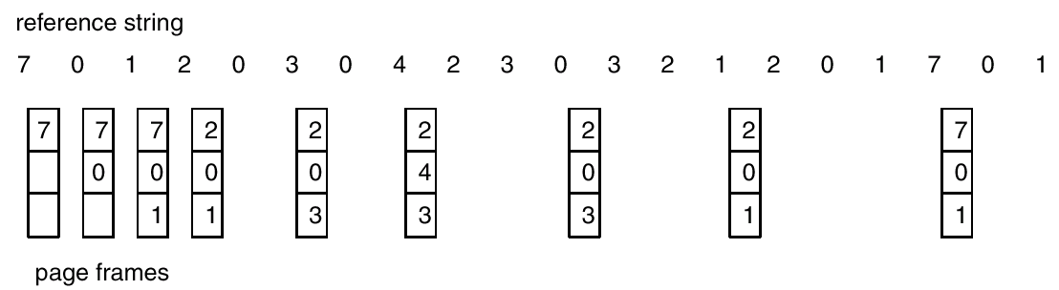
Optimal Page Replacement
Operating System Concepts

Slide 144
Optimal Page Replacement Algorithm
4 frames example
1, 2, 3, 4, 1, 2, 5, 1, 2, 3, 4, 5
1
2
3
4
4
6 page faults
5

Slide 145
Optimal Page Replacement Algorithm
It has the lowest page-fault rate of all algorithms and will never suffer from Belady's anomaly. Such an algorithm does exist and has been called OPT or MIN.
It is difficult to implement, because it requires future knowledge of the reference string.

Slide 146
Least Recently Used

Slide 147
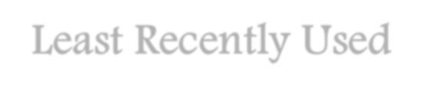
Least Recently Used
LRU replacement associates with each page the time of that page's last use.
When a page must be replaced, LRU chooses the page that has not been used for the longest period of time.

Slide 148
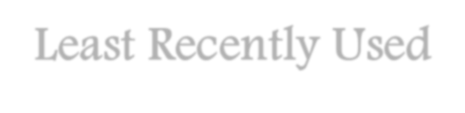
Least Recently Used
Page frame size=4
1
1
2
1
2
3
1
2
3
4
1 | 1
2 | 2
3 | 3
4 | 4
1
2
5
4
1
2
5
4
1
2
5
4
1
2
5
3
1
2
4
3
5
2
4
3
Page Fault = 8

Slide 149

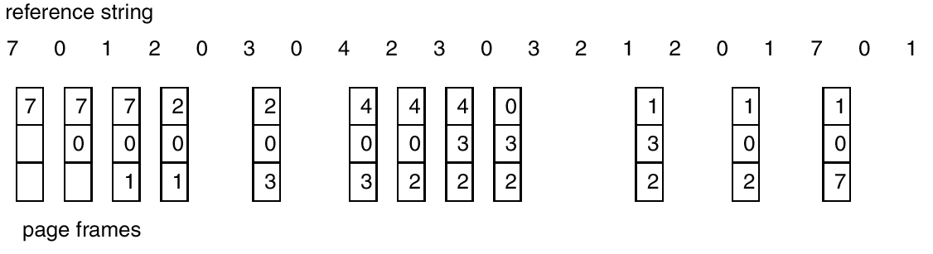
LRU Page Replacement
Operating System Concepts

Slide 150
Thrashing

Slide 151

Thrashing
If a process does not have “enough” pages, the page-fault rate is very high. This leads to:
low CPU utilization.
operating system thinks that it needs to increase the degree of multiprogramming.
another process added to the system.
Thrashing ≡ a process is busy swapping pages in and out.
Operating System Concepts

Slide 152

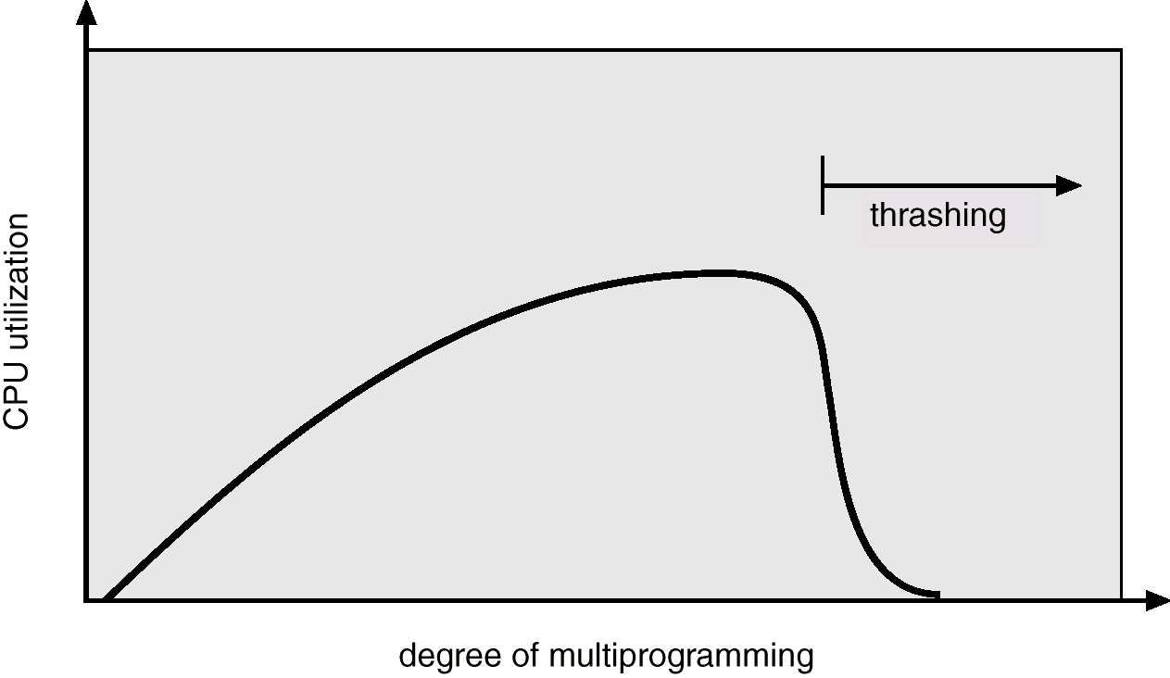
Thrashing

Slide 153


Consider the following page reference string 1, 2,3,4,5,2,6,7,3,2,4,1,7,1,4,3,2,3,4,7,1. Compare the number
of page faults with frame sizes 3 and 4 with LRU replacement algorithm.

